Slide 1
Analysis of the Effect of News Headlines on the Stock Market
Notes:
© Copyright Showeet.com – Creative & Free PowerPoint Templates

Slide 2
Begin with an outline
01
04
Overview of the project
Methodology
02
05
Problem Definition
Deliverables
03
06
Project Scope
Technologies
Notes:
© Copyright Showeet.com – Creative & Free PowerPoint Templates

Slide 3
Overview of the project
The ready availability of data today enables investors of all levels of expertise to make better investment decisions.
However, data is siloed and the challenge is determining which data is relevant, then ingesting and integrating the data into a usable format.
The question is, can we use current news content to predict relative stock price performance?
This research demonstrates that the prediction of percentage stock returns is improved by the inclusion of news sentiment as a feature for predictive model training.
The results will be shown for both Apple and Microsoft stock using trending news articles.
Notes:
© Copyright Showeet.com – Free PowerPoint Templates

Slide 4
Problem Definition
There are fast changes in the stock market. It's tough to predict what will happen to a specific company's stock or the general stock market.
When the stock market trends can be predicted for the day itself or the next day, a substantial sum of money can be saved.
Seeing a link between news headlines and the trend in the stock market is not unusual.
If a business receives adverse press, it is understandable that as a result of this negative news, the stocks of this specific business will go down and vice versa.
It may be feasible to predict the stock market trend in general or that of a specific business by evaluating news headlines.

Slide 5
Project Scope
Hypothesis
The performance of algorithms varies for different products.
Scope
The goal of this project is to contribute to the development of a stock forecasting tool.
This tool will include a diverse set of statistical and machine learning techniques.
Its primary objective will be to reliably anticipate the movement of stock for a variety of items on the market.

Slide 6
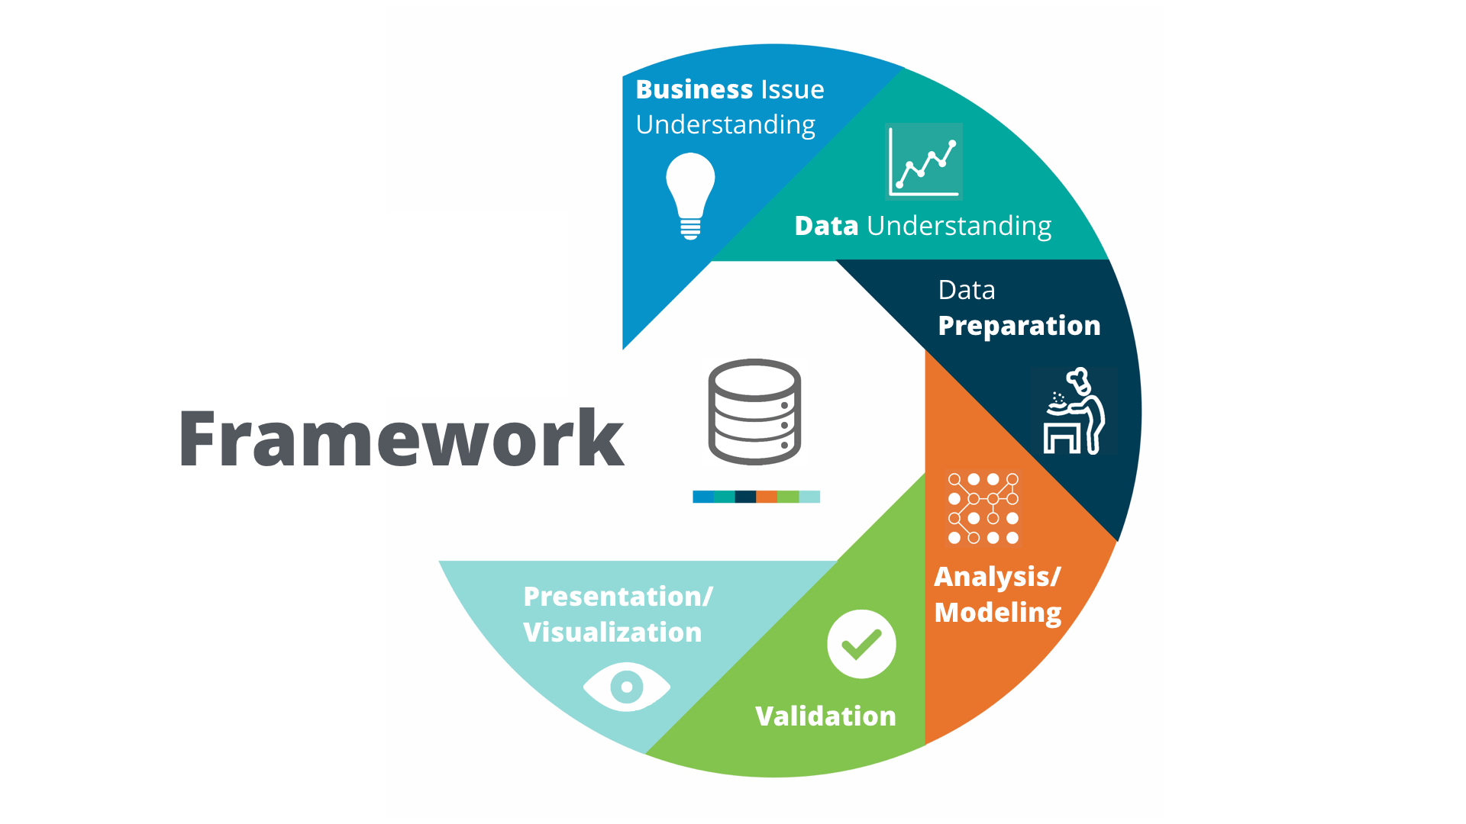
Methodology

Slide 7

Deliverables
User can predict the changes in the stock based on the given NEWS headlines.
System will inform the user about the upcoming features.
Deliverables will be as web application.

Slide 8
Tools & Technologies
programming languages → Python3, HTML5, CSS
Algorithms → Linear Regression, SVM, Adaboost
Libraries → SKlearn, Pandas, numpy, matplotlib
Tools → Pycharm

Slide 9
Modeling
Linear Regression
Linear Regression: A linear approach to model the relationship between stock price and News Headline.
Explanatory Variable: News Headline.
Dependent Variable: Stock price.
SVM (Support Vector Regression)
SVM Regression: Performs linear regression in a high-dimensional feature space.
Loss Function: Uses ∈− insensitivity loss to minimize model complexity.
Kernel Parameters: Performance depends on good settings of C, ∈, and kernel parameters.

Slide 10
Modeling
Random Forest
Random Forest: Overcomes overfitting by training multiple decision trees.
Subspaces: Each tree operates on distinct subspaces of the feature space.
Splitting Criteria: Decision tree split based on impurity measures like Shannon Entropy or Gini impurity.
K-nearest neighbor
K-nearest neighbor (KNN): Simple and easy-to-implement algorithm.
Classification based on Resemblance: Maps historical stock data and test data into vectors.
Similarity Metric: Calculates Euclidean distance to make predictions.
Prediction Process: Majority vote of k closest neighbors determines class label for query record.

Slide 11
Modeling
AdaBoost
AdaBoost: Boosting machine learning algorithm using PAC learning model.
Iterative Process: Weak learning algorithm called iteratively for multiple rounds.
Sample Weights: Samples are assigned weights in each round to focus on hard samples.

Slide 12
Evaluation
Data Split: Data divided into two ratios (80:20 and 90:10) for training and testing the models.
Evaluation Metrics: Mean Squared Error (MSE) used to measure the performance of each model.
Mean Squared Error (MSE): MSE calculates the average squared difference between estimated values and actual values.
MSE Interpretation: Lower MSE indicates better accuracy; it's always non-negative.
Models Evaluated: Six models applied - Linear Regression, SVM, Random Forest, K Nearest Neighbor, AdaBoost, and Principal Component Analysis.

Slide 13
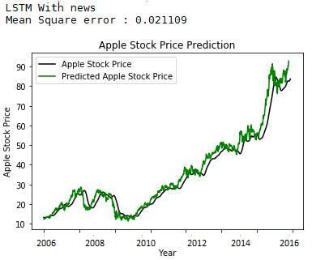
Results
Algorithm | Mean Square Error
Linear Regression | .030405
SVM | .039476
Random Forest | .030875
K Nearest Neighbors | .040080
AdaBoost | .028845
PCA with Random Forest | .032061

Slide 14
Implementation Flow
Step - 1
Data collection, Data Wrangling
Step - 2
Model Creation, training
Step - 3
Evaluation & Web app
Step - 4
Deployment

